Slide 1
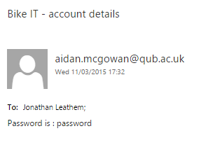

Forgot Password Page
One minor defect
Email subject reads “Bike IT – account details”
Appears unprofessional
Three cosmetic defects
Notes:
Forgot password functions fine
User should know themselves that they entered a forgot password request on the Pizza IT site and that they’ll soon receive an email containing their password
Won’t affect the running of the site
Recommend changing the email subject to “Pizza IT – account details” to make company as a whole appear more professional and for complete clarity with customers
Three cosmetic defects:
Web page spacing on Samsung Galaxy S4, iPhone 6, and Amazon Kindle Fire 7”.
Positioning of the Pizza IT logo on the logo in comparison to other pages.
Watermark “99” on the Pizza IT logo.

